Slide 1
Experimental and Computer Laboratory FS2026 Time schedule
MODULE 1 – FREQUENCIY ANALYSIS
20.03 | Introduction to Anaconda and VS code Module 1 project presentation
27.03 | Module 1 – review
17.04 | Module 1 – project hand in deadline
MODULE 2 – TIMESERIES ANALYSIS
08.05 | Introduction to Git and GitHub Introduction to Git project workflow Module 2 project presentation
15.05 | Module 2 – review
29.05 | Module 2 – project hand in deadline

Slide 2


Module 2 – Timeseries analysis
International Relations and Transboundary Cooperation

Slide 3
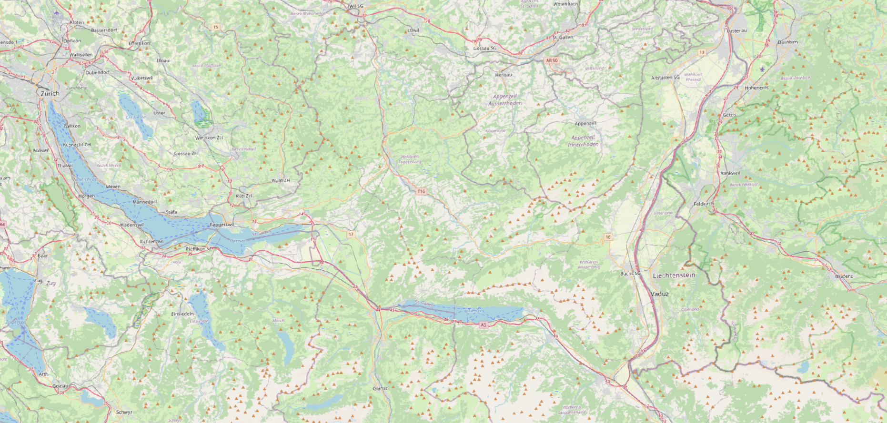
Case Study : Rhein –Ill confluence
Rhein
Ill

Slide 4
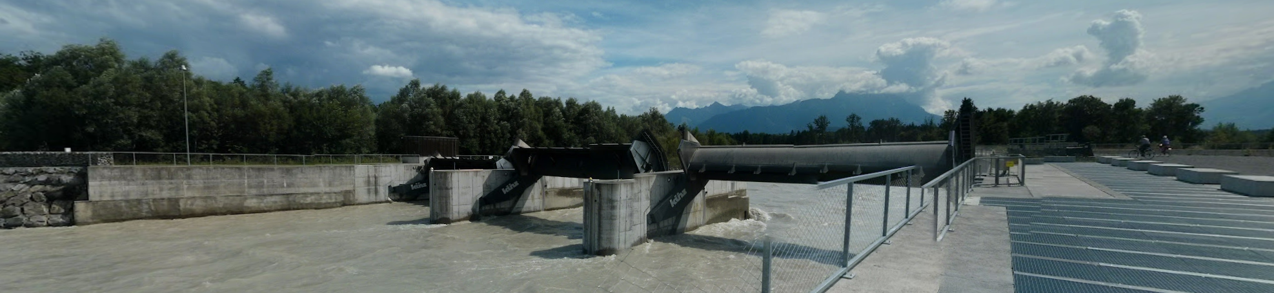

Illspiz Kraftwerk
45 m
3.5 m

Slide 5
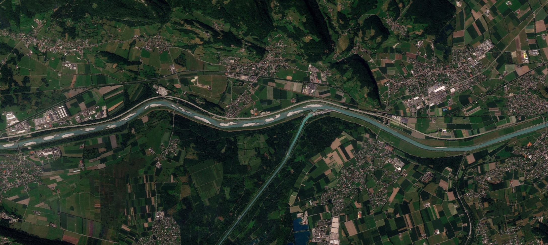

Ill – Rhein confluence
HYDROLOGICAL INFLUENCE
19th August 2025
Rhein
Rhein
Ill
1km
1km

Slide 6
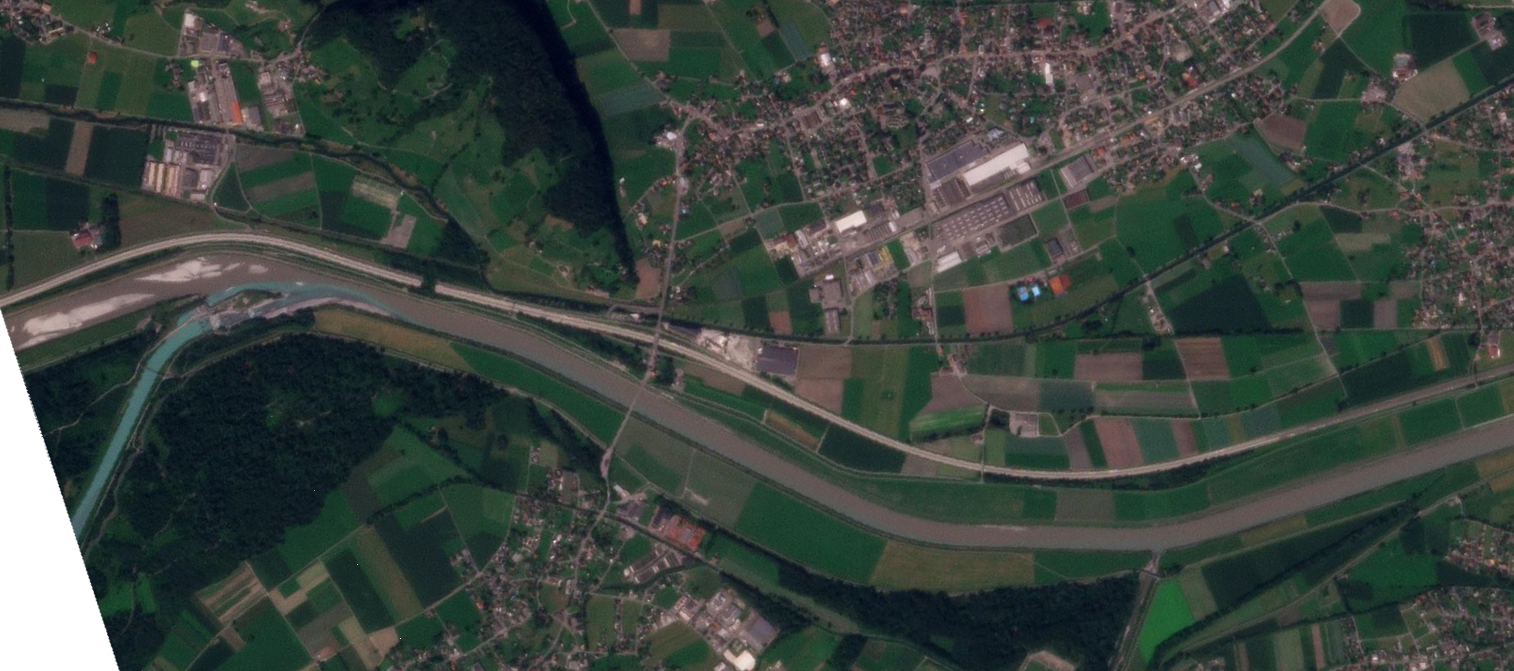
Ill – Rhein confluence
SEDIMENT INFLUENCE
Rhein
28th August 2024
Rhein
Ill
1km
1km

Slide 7
Dataset
Diepoldsau
Gisingen
2003-2021: C suspended sediment concentration (g/L – 15min)
1976-2013: Q discharge (m³/s – 15min)
Diepoldsau, Rietbrücke
2012-2025: C suspended sediment concentration (g/L – 10 min)
1984-2025: Q discharge (m³/s – 10 min)
Gisingen
Rhein
Ill

Slide 8
Module 2: timeseries analysis
Diepoldsau
Timeseries review
Timeseries Modelling
Timeseries application & evaluation
Ill to Rhein relative sediment influence
Independent variables?
Gisingen
OUTPUT:
Rhein
Ill
A Jupyter notebook to run (must run when I test it)
For each section, a .py file with all the functions
Each section independent from each other
Title at the start of each section & results/comments in the end of each section
lagostin@ethz.ch

Slide 9
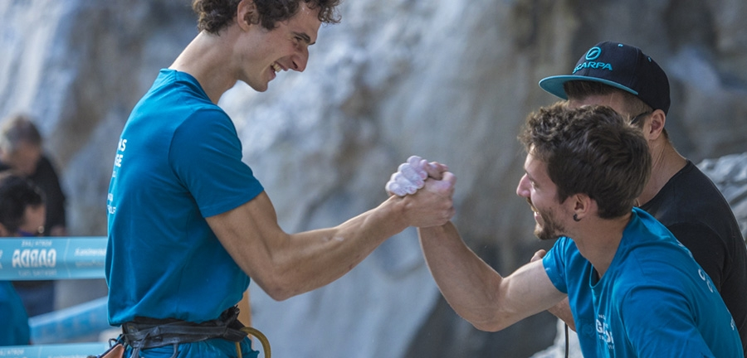
Rules of the Game
Work together within the group to create the code – share the results and comment freely with the class ( better if on the Moodle Forum)
Codes within groups must be different, same code between groups will be penalized
Codes must run: code with errors will not be graded
Grading will be on:
Readability of the code ( AI slop, long unnecessary code and ugly code formatting is bad)
Comprehension of the statistical methods (hypothesis, assumptions and shortfalls)
Interpretation of the results
lagostin@ethz.ch

Slide 10
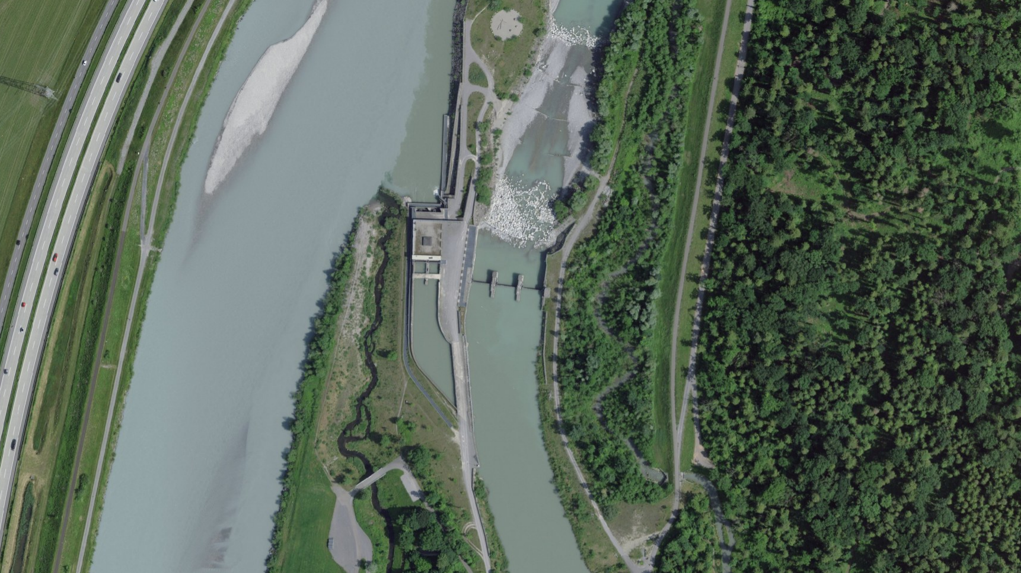

Slide 11


Coding - good coding environment

Slide 12
GitHub - good collaborative coding
Install Git and Git Bash Make sure to login to your GitHub account
Create a Git repository (locally)
Create a .gitignore
Make some changes to the code, commit ( both from bash and from vs code)
Publish branch to your GitHub account ( make it private)
Go online ( general settings) and invite a collaborator ( your group colleague)
Branch the Main – Publish to GitHub ( do some work and some commits)
Pull Request ( Open Changes – make some comments – code suggestions)
After Merging – delete branch

